Slide 1
A Minimal OS for Cloud Computing
MicroswiftOS:
Yiran Menghui Chaowen Junhan

Slide 2
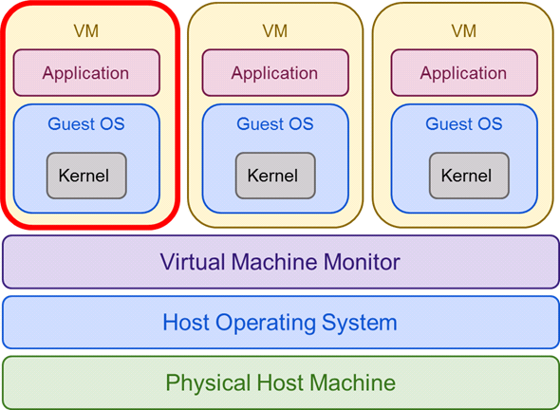
Motivations
Cloud apps are different!
Dedicated VM
Availability matters
Unused OS features

Slide 3
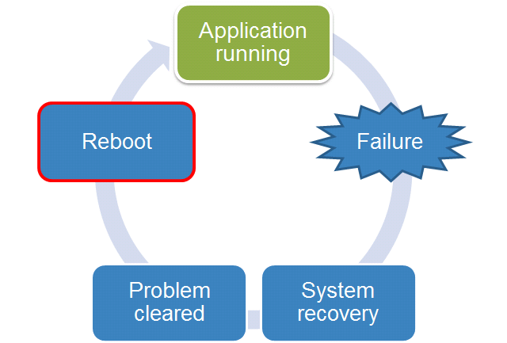
Goals
MicroswiftOS!
- Optimized for use in cloud computing
Minimal size
Faster boot-up

Slide 4
Kernel Optimizations
Profiling User-mode Linux:
perf, gprof, FlameGraph
Change Kernel configurations
Device drivers
Loadable module support
Kernel hacking
...

Slide 5
System Optimizations
Build a minimal software environment
Build from scratch. Install only necessary tools: glibc, binutils, gcc, important libraries, kernel headers, ...
Change system configurations
Disable initramdisk
Disable fsck
Boot scripts

Slide 6
Evaluation
MicroswiftOS vs. Arch Linux (baseline)
System completeness
System size
OS Boot-up time

Slide 7
Evalutaion: Completeness
Goal: to verify the correctness of MSOS
Workloads:
Network service: thttpd
Scientific computing:
max-flow solver
LP solver
linear equation system solver
I/O benchmark: inter-process communication

Slide 8
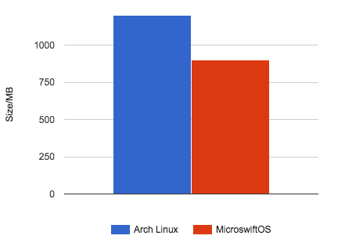
Evalution: System Size
Operating system size after installation:
Arch Linux ~1200MB
MicroswiftOS ~900MB
~25% space savings

Slide 9
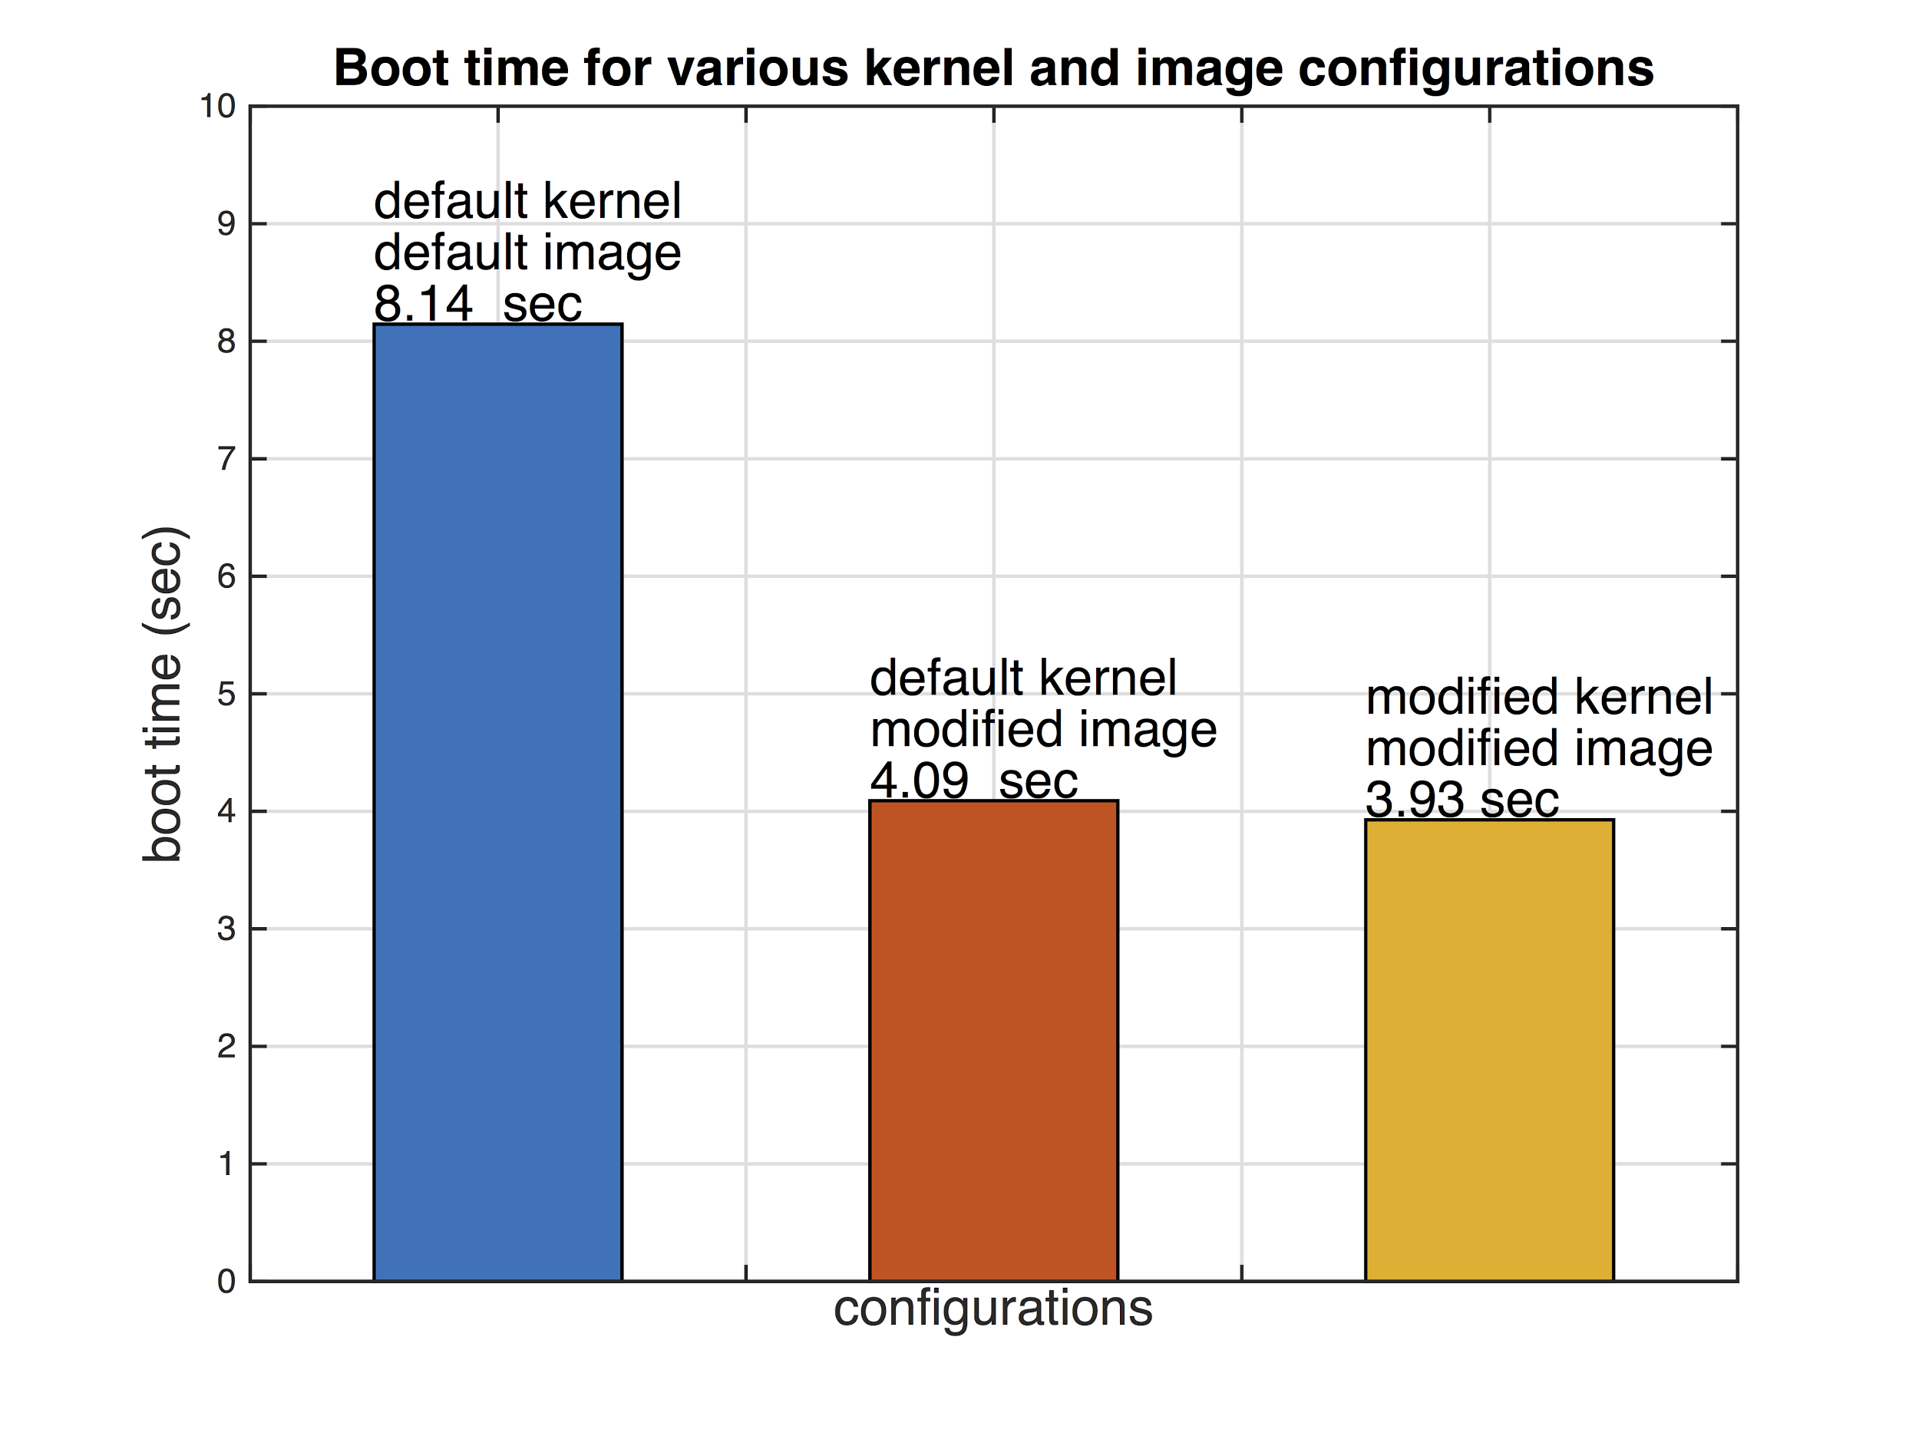
Evaluation: Boot-up Time
4.09/8.14=50.2%
3.93/8.14=48.3%
>50% time savings

Slide 10
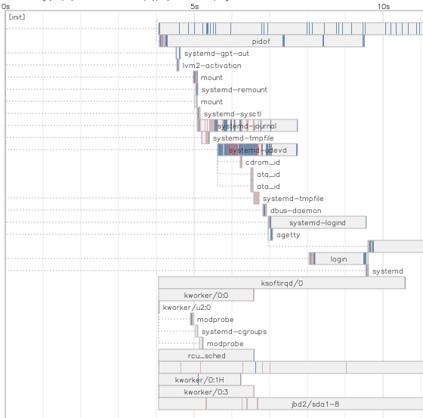
Bootchart2 Analysis
Arch Linux
Kernel booting
~ 4.0 seconds
Before login starts
~ 8.0 seconds
29 processes

Slide 11
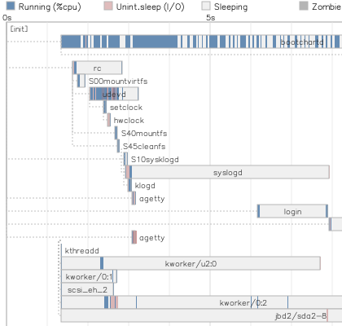
Bootchart2 Analysis
MicroswiftOS
Kernel booting
~ 1.3 seconds
Before login starts
~ 6.2 seconds
19 processes

Slide 12
Q & A
Thank you!

